Slide 1
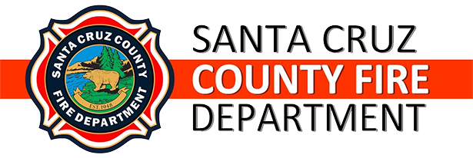
FIRE DEPARTMENT ADVISORY COMMISION
JULY 17 2024
LAFCO FIRE STUDY

Slide 2
LAFCO SPECIAL FIRE STUDY
Timing of Final Report
Purpose of Study
  Explore the Annexation of portions of CSA 4 8to other Fire Districts
    Pajaro Valley fire Annexation Request
    Other Agencies
  Impacts of Consolidation of Fire Districts and CSA 48

Slide 3
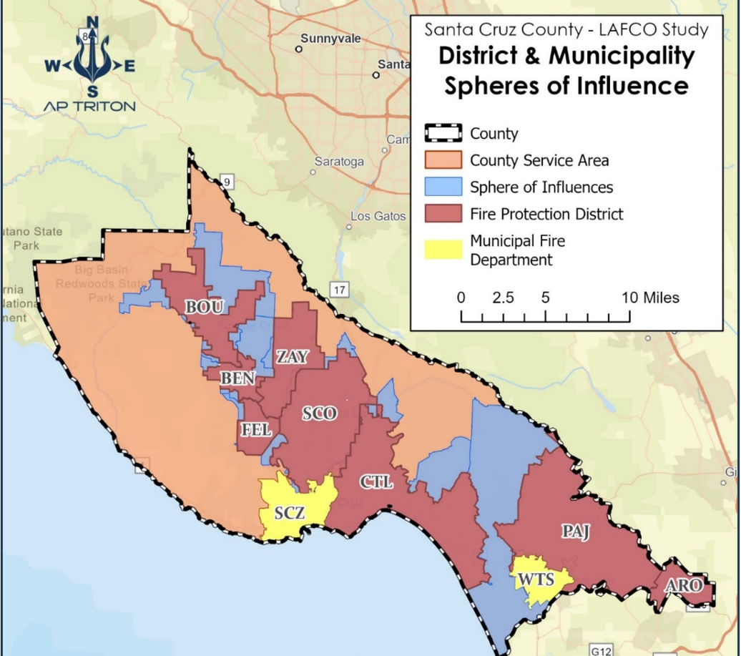
Currently 11Individual Fire Districts throughout our County
5 districts are multiple station Districts
  Santa Cruz County
  Santa Cruz City
  Watsonville City
  Scotts Valley
  Central Fire
6 districts Single Station Districts
  Boulder Creek
  Ben Lomond
  Zayante
  Felton Fire
  Pajaro Valley Fire
  Pajaro Dunes

